Slide 1
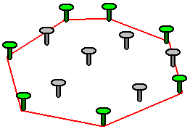
Golgi Convex Hull program
Creates convex hull (smallest convex set that contains a given set of points or a shape) in selected ROI of the Golgi complex
To quantify how dispersed the Golgi is
Also, automatically sets scale by detecting the scale bar
Programmed in python
Concept of a convex hull

Slide 2
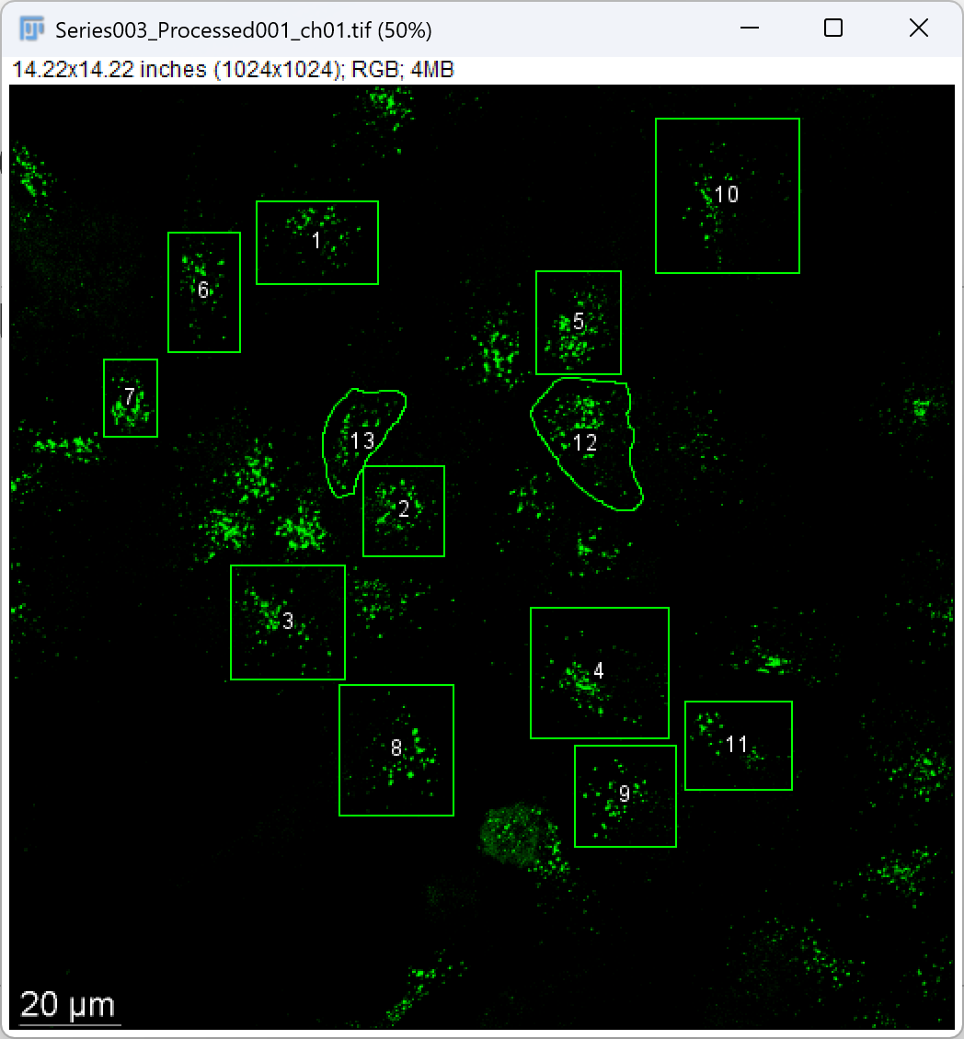
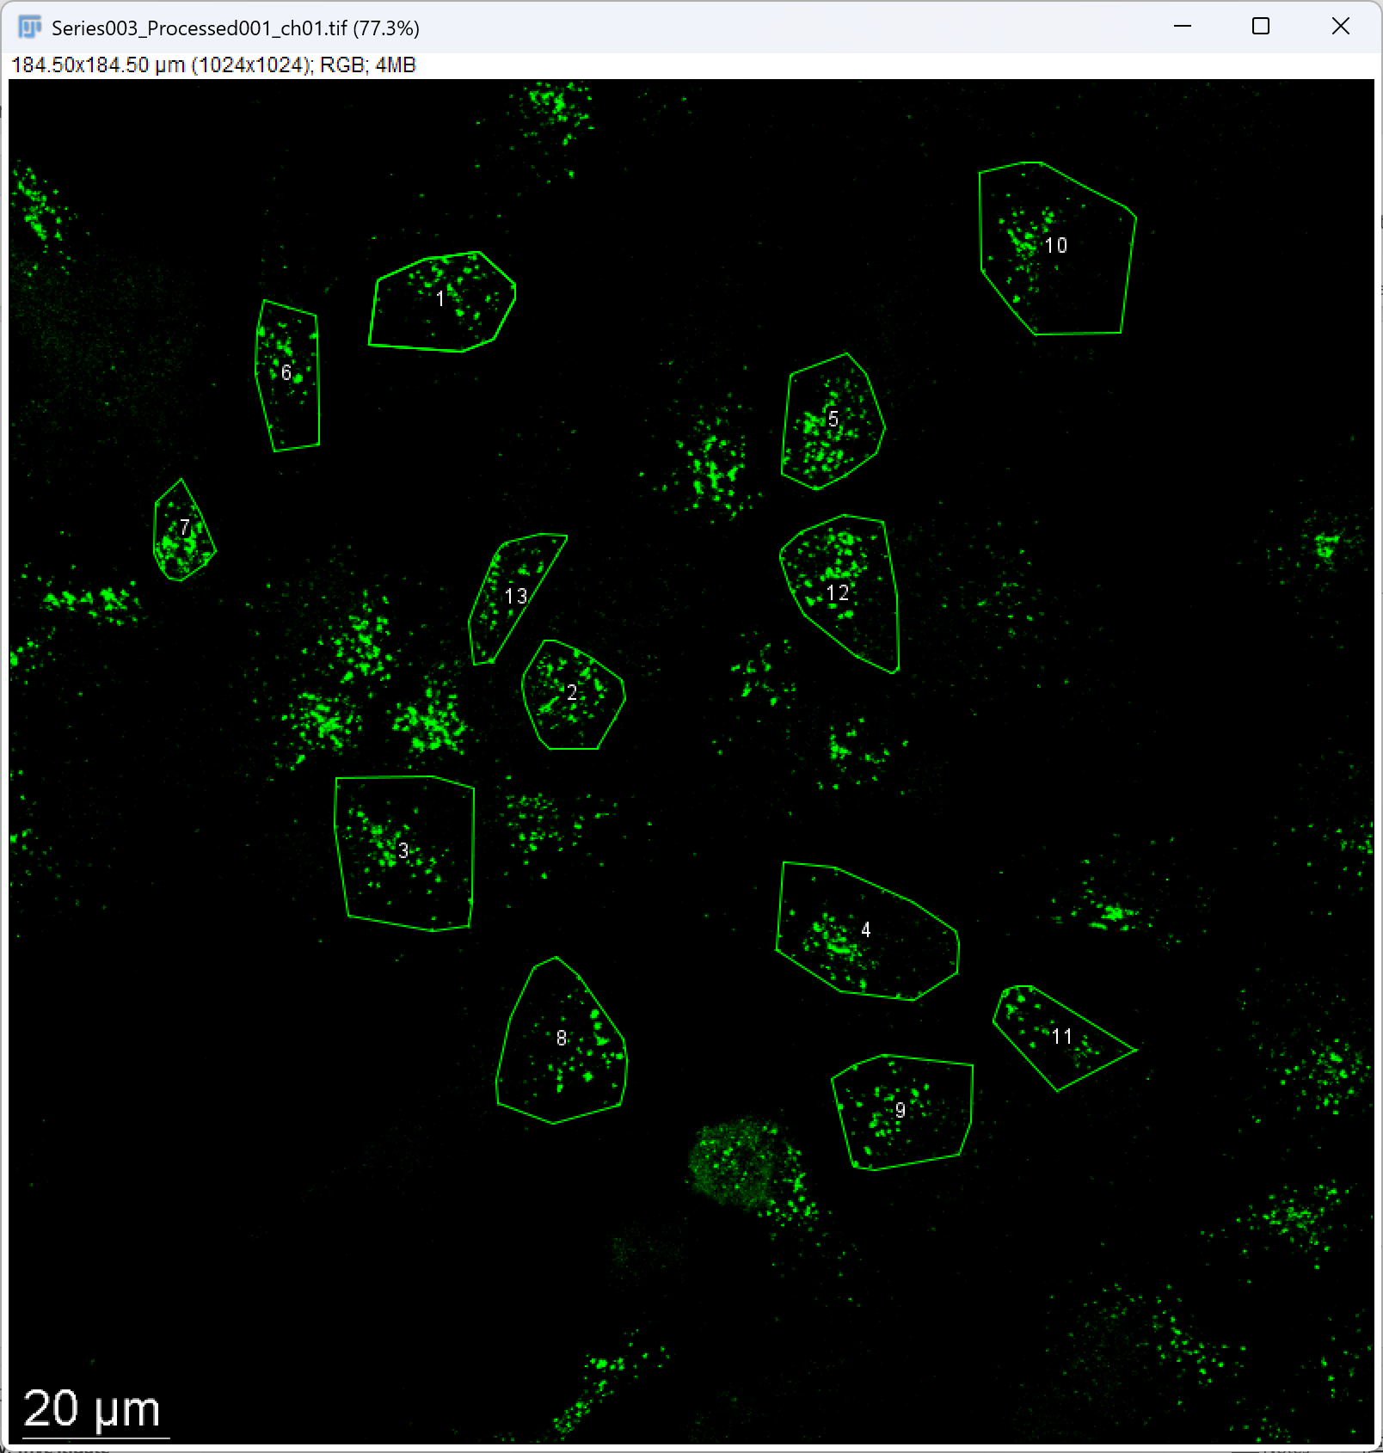
Example

Slide 3
Prerequisitions
Install Anaconda (including Python) (https://www.anaconda.com/download)
ROI area needs to be selected & saved as .zip file

Slide 4
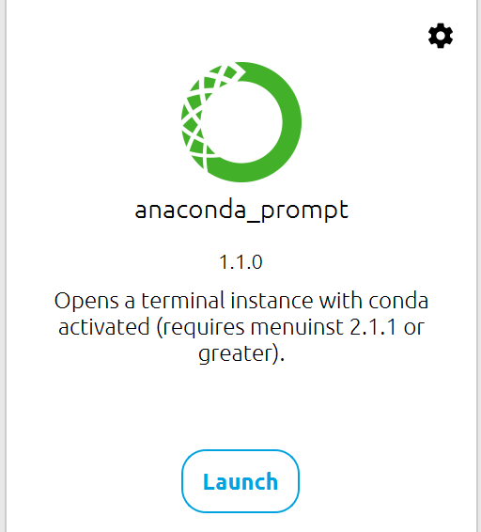
Prerequisitions
Open anaconda prompt after installing Anaconda
Type the following:
cd [Insert the folder location]
pip install -r requirements.txt
python golgi_convexhull.py
Check if requirements.txt and golgi_convexhull.py is in the same folder

